Slide 1







Republic of Tunisia
Ministry of Higher Education and Scientific Research
Software Architecture Engineering
Defense of end-of-study project
Enhancing User Experience Through Integrated Analysis
Academic Supervisor:
Chaima Ayari
Corporate Supervisor:
Mohamed Ben Salem
Realized By :
Wissal Messadi
Academic year: 2024-2025
Notes:
Good [morning/afternoon], esteemed jury members, professors, and colleagues.
It is a privilege to present my end-of-study project, "Enhancing User Experience Through Integrated Analysis." This project represents the culmination of my learning in Software Architecture Engineering and focuses on innovative solutions to enhance user experience.
I sincerely thank my academic supervisor, Chaima Ayari, and my corporate supervisor, Mohamed Ben Salem, for their invaluable support.
I also extend my gratitude to the jury members, Mohamed Rjab and Radhia Werghemmi, for dedicating your time to assess my work.
I am eager to share the details of this project with you and look forward to your questions and insights.

Slide 2



AGENDA
1
2
3
4
5
Overview
Problem Statement
Solution Overview
Methodology
Data Prepration
6
Modeling and evaluation
7
Conclusions

Slide 3
01
Overview

Slide 4









General Context
Focus of the Telecommunications Industry
Improving service quality
Optimizing network performance
4
Notes:
In today’s world, telecommunications play a critical role in connecting people and supporting essential services. As technology advances, there's a strong focus on improving the quality of these services and ensuring that networks operate efficiently and reliably. This context drives the need for innovative solutions to manage and enhance network performance, ultimately providing a better experience for users.

Slide 5


Company Overview
Global Presence
Employees
Customer Base
Patents
Licensing Agreements
170+ countries and regions
207,000
Serving 3+ billion people
140,000+ active patents (end of 2023)
200+ patent licensing and cross-license agreements
5
Notes:
Let me introduce the host company for this project: Huawei. As a global leader in telecommunications and technology, Huawei operates in over 170 countries and regions, reaching more than 3 billion people worldwide. With a team of 207,000 employees and over 140,000 active patents, Huawei is dedicated to innovation and excellence. Their strong presence and commitment to advancing technology make them an ideal partner for exploring solutions to enhance network performance and improve user experience.

Slide 6
02
Problem Statement

Slide 7



Current Situation
Reactive
Lacks end-to-end visibility
Fragmented data
Monitor network
Network Operation Center
Diagnose issues
Coordinate Support
7
Notes:
The current situation relies on the Network Operation Center, or NOC, to monitor and manage network performance. Its main roles include tracking key metrics, diagnosing issues, and coordinating field support.
However, this approach has limitations. It’s reactive, addressing issues only after they occur, which delays resolution. It also provides limited visibility into user experience, and data is siloed across departments, leading to fragmented analysis. These challenges highlight the need for a more proactive, user-centered approach.

Slide 8
Problem Statement
How can we improve the monitoring of service quality for proactive management?
What strategies can enable faster issue resolution to enhance user experience?
How do we integrate fragmented data to support better decision-making?
8
Notes:
Building on the limitations of the current NOC model, here are the core challenges that need addressing. First, how can we improve monitoring to ensure proactive management of service quality? Second, we need strategies for faster issue resolution that will enhance the overall user experience. Lastly, integrating fragmented data is essential for making more informed decisions.
These questions guide the problem statement for our project, highlighting the need for a system that not only monitors but also proactively manages network performance, focusing on user-centered metrics and data integration.

Slide 9
03
Solution Overview

Slide 10





Service Operations Center
Improved Satisfaction
Predective Monoroting
Faster Resolutions
Cross-Department Collaboration
Strategic Insights
Unified Monitoring
10
Notes:
The Service Operations Center (SOC) is a solution that unifies monitoring and enables real-time insights. It ensures proactive issue resolution, fosters collaboration, and drives improved network performance for better user experiences.

Slide 11
NOC vs SOC : key differences
Monitoring Focus
Approach
Analysis Scope
Metrics Used
11
Notes:
This slide compares the NOC and SOC, showcasing how the SOC offers a more advanced, user-focused approach.
Monitoring: NOC focuses on network metrics, while SOC monitors end-to-end service quality, integrating user-centric metrics.
Approach: NOC is reactive; SOC is proactive, resolving issues before they impact users.
Analysis: NOC limits scope to network performance, while SOC analyzes service degradation and user impact.
Metrics: NOC uses KPIs; SOC combines KPIs and KQIs for a holistic view.
In short, while the NOC keeps our networks running, the SOC ensures that the service we provide meets and even anticipates our customers’ needs, making it essential for building a more customer-centered, strategic approach to our operations."

Slide 12
Fonctionnel Requirements
Service Quality Monitoring and Metrics Collection
Proactive Issue Detection and Resolution
Impact Analysis and User-Centric Reporting
Cross-Department Communication and Data Sharing
Performance Management and Optimization
Real-Time Dashboard and Alerts
12
Notes:
To support the SOC’s mission, we’ve outlined key functional requirements essential for maintaining high service standards.
First, Service Quality Monitoring ensures we track both Key Quality and Performance Indicators, allowing us to uphold high standards from the user’s perspective.
Proactive Issue Detection helps us identify and address potential problems before they impact customers, minimizing disruptions.
Impact Analysis and Reporting focuses on understanding how any service issues affect user experience, making sure our responses are customer-centered.
Cross-Department Communication facilitates seamless data sharing with teams like customer support and marketing, ensuring unified and effective customer service.
Performance Optimization allows us to analyze patterns to prevent issues and continuously improve service quality over time.
Lastly, a Real-Time Dashboard with Alerts enables our team to respond quickly to any anomalies, keeping our service reliable.
Together, these requirements empower the SOC to deliver quality service and enhance the overall customer experience."

Slide 13
Non Fonctionnel Requirements
Security and Data Protection
Efficiency and Resource Optimization
High Availability
Scalability
13
Notes:
Alongside our functional requirements, we have outlined key non-functional requirements to ensure that our SOC operates at a high standard of performance and reliability.
First, Security and Data Protection is critical, as the SOC deals with sensitive customer data. Robust security measures will safeguard data and comply with regulatory standards.
Efficiency and Resource Optimization ensure that the SOC runs smoothly, using minimal resources while still providing quick, reliable insights. This keeps our operations cost-effective and responsive.
Next is High Availability. The SOC needs to operate continuously, with minimal downtime, so it can monitor and respond to issues at any time, maintaining uninterrupted service.
Scalability. As our service and user base grow, the SOC must be able to handle increased data and demand without compromising performance.
Together, these non-functional requirements provide a strong foundation, ensuring that our SOC remains robust, secure, and capable of supporting our mission to enhance the customer experience."

Slide 14
04
Methodology

Slide 15
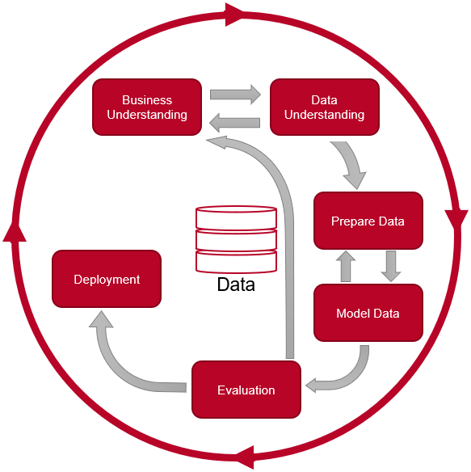
Methodology Crisp-DM
Flexible and iterative process
Facilitates effective communication among stakeholders
Provides a clear roadmap for project execution
15
Notes:
We chose the CRISP-DM methodology, a structured, six-phase approach ideal for data-driven projects.
Business Understanding: We start by defining project objectives and identifying the key requirements for success.
Data Understanding: Next, we gather and explore data to ensure it aligns with our project goals.
Data Preparation: In this phase, we clean and structure the data, getting it ready for modeling.
Modeling: Here, we build and test models to generate actionable insights.
Evaluation: We assess the models to ensure they meet business objectives and provide meaningful results.
Deployment: Finally, we implement the models, integrating them into our operations for practical use.
This approach is flexible and iterative, allowing us to refine as we go. It also promotes effective communication among stakeholders and provides a clear roadmap for project execution

Slide 16
Technologies and tools
Python(Programming Language)
Huawei Jupyter Notebook (Customized) (Text Editors)
Huawei VS Code (Customized)(Text Editors)
PostgreSQL(Database and Connectivity)
psycopg2 (Database and Connectivity)
NumPy(Frameworks)
Pandas(Frameworks)
Scikit-learn(Frameworks)
Dask (Frameworks)
Power BI (Visualization)
16
Notes:
In this project, we leveraged several tools and technologies to support data processing, analysis, and visualization. Python was our primary programming language, chosen for its versatility and vast ecosystem of libraries, which facilitated both data handling and machine learning tasks. Huawei provided customized versions of Jupyter Notebook and VS Code, which streamlined our code development process.
For data storage and management, we used PostgreSQL, a robust and scalable database, with the psycopg2 library allowing seamless Python integration.
In terms of data manipulation, we relied on NumPy and Pandas for efficient data handling, while Dask was essential for parallel computing, enabling us to process large datasets quickly. Scikit-learn supported our machine learning and predictive modeling efforts.
Finally, for data visualization, Power BI allowed us to create interactive dashboards and reports, making our findings accessible and actionable for stakeholders."

Slide 17
05
Data Preparation

Slide 18
Data source :From xDRs to Insights
PS/LTE probe
Collect xDRs from PS/LTE Probes.
Process through DPU and CAU.
Analyze in IMC and Spark.
Store SDRs in Carbon.
Send xDRs
1
DPU
Distrbution xDRs
2
Send xDRs
CAU
IMC cluster
3
3
4
4
Carbon obtains
15 min SDRs
Send xDRs
Send 15-min KPIs
And 15 min SDRs
Spark
Carbon
5
Hadoop cluster
18
Notes:
This slide outlines the journey of transforming raw network data into actionable insights through a structured process. It highlights how we collect, process, and refine data to create SDRs, which are the foundation of our analysis. Now, let me walk you through the process briefly.”
“The process begins with the collection of xDRs from PS/LTE probes, which capture detailed network activity such as IP traffic and LTE events. These xDRs are then processed through the DPU for distribution and the CAU for aggregation and conversion into a usable format. The data is further analyzed in the IMC Cluster and Spark environment, where it is summarized into SDRs, or Summary Data Records. SDRs provide high-level summaries that include key performance metrics like throughput and latency, insights into streaming and browsing activities, and data covering 2G, 3G, and 4G technologies. Each SDR is structured with fields such as cell identification, technology type, and timestamps, ensuring reliable and complete data. This structured format allows us to explore trends, identify patterns, and ensure data quality, making SDRs a robust foundation for mobile network performance analysis.

Slide 19
Data Preparation: From Raw Data to Structured Insights
Raw Data
Data Transformation (KPI/KQI Calculation)
Data Integration (Merged Tables)
Structured Dataset.
19
Notes:
Our data preparation phase aimed to transform raw network data into a structured format ready for analysis. We started by calculating KPIs and KQIs for different service types, such as streaming and browsing, using predefined formulas. Data was split by technology—4G, 3G, and 2G—to ensure accuracy in analysis. The key outcome was a unified dataset, enriched with calculated metrics, enabling deeper insights into network and service performance.

Slide 20






Data Transformation: Calculation KPI and KQI
Output Sheets
2G
Raw data in PostgreSQL
Streaming Service
3G
Browsing Service
video streaming start uccess tare
Get Response Success rate
*
initial buffer Success Rate
Page response Success rate
First get Success
-------------------------
first get request
4G
20
Notes:
In the data transformation phase, we calculated KPIs and KQIs for our datasets. KPIs, like Page Response Success Rate or Streaming Delay, measure performance at a granular level using predefined formulas. KQIs aggregate these metrics to evaluate service quality, such as browsing or streaming success rates. For example, the Streaming Start Delay is calculated as the sum of DNS Delay, GET Response Delay, and Buffer Delay. To ensure accuracy, we separated data by technology—2G, 3G, and 4G—and tailored KPI formulas for each layer.

Slide 21
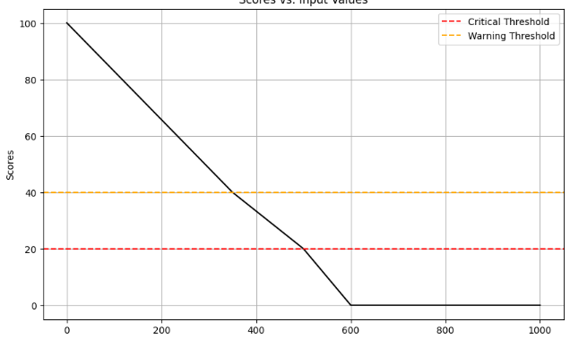
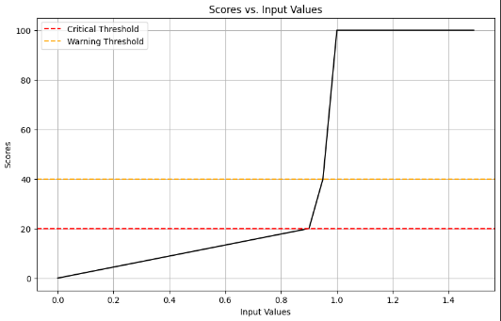
Feature Engineering: KQI Score Calculation
Each service has specific Key Quality Indicators (KQIs) with predefined critical and warning thresholds to monitor performance..
Web_page_response_delay_to_Score
Video_Streaming_Start_Success_Rate_to_score
[Video_Streaming_Start_Success + Video_Streaming_Start_Delay + Video_Streaming_Plays_Disconnected_Rate+ Video_Streaming_Download_Throughput + Video_Streaming_Stalled_Time_Rate + Video_Streaming_xKB_Start_Delay]/6
21
[Web_page_response_Success_RateWeb_page_browsing_Success_Rate+Web_page_response_delay+ Web_page_browsing_delay + Web_page_Download_Throughput_kbps]/5
Notes:
In the feature engineering phase, we focused on creating a composite service quality score using the calculated KQIs. We applied thresholds to each KQI to assign scores, categorized into Critical and Warning levels. For instance, if the Video Streaming Start Success Rate fell below 90%, it received a critical score of 20, while values between 90% and 95% received a warning score of 40. These scores were then averaged to compute a composite quality score for each service category. This final score serves as a key metric for analyzing service quality and optimizing performance.
---------------------------------------------------------------------
KQI Score Calculation Process:
Predefined thresholds applied to each KQI determine scores.
Scores categorized into Critical and Warning levels:
Critical Score: Assigned when values exceed critical thresholds.
Warning Score: Assigned for values within a warning range.
-----------------------
->>>>> Explain why these thresholds are significant. For example: "The critical and warning thresholds help monitor performance and ensure timely responses to service degradations

Slide 22
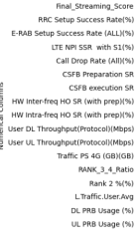
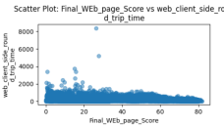
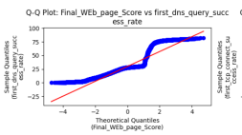
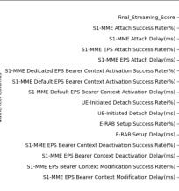
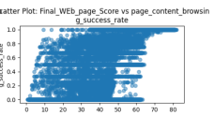
Exploratory Data Analysis
No Linear relationship
Non-normal Distribution
22

Slide 23
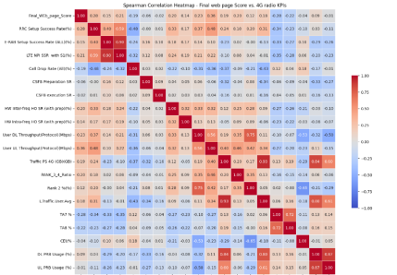
Feature Selection
Define thershhold for the weak corealtion for each table and the iportance of the feature
23
Notes:
Based on our EDA findings, we conducted feature selection using Spearman Correlation Analysis, a method suited for non-linear and non-normal data. This allowed us to evaluate the strength of relationships between features and the KQI Score. Features with correlation coefficients above ±0.3 were selected, including page_content_browsing_success_rate with a strong positive correlation of +0.45 and dns_query_delay with a moderate negative correlation of -0.33. This process resulted in a final set of 20 features spanning success rates, throughput, and latency metrics, optimized for relevance and computational efficiency.
-------------------
Ensure that removing weak features doesn’t cause overfitting or underfitting

Slide 24
06
Modeling and Evaluation

Slide 25
Modeling
Prediction
Generate actionable recommendations by analyzing KPI similarity among network cells.
Recommendation
Identify and understand the key factors driving variations in service quality.
25
Notes:
Our machine learning modeling focused on two key objectives: prediction and recommendation. These tasks aim to enhance network performance and service quality through data-driven insights."
Prediction Task: "The prediction task focused on forecasting KQI Scores using network performance metrics like success rates, throughput, and latency. The goal was to identify key factors affecting service quality and use this understanding for optimization."
Recommendation Task:( knn and cosine are complementary ) "Using the predictions and feature analysis, the recommendation task aimed to generate actionable insights for network improvement. For example, recommendations might include increasing throughput in underperforming cells or reducing latency in specific areas."
Conclusion: "Together, these tasks provide a comprehensive framework for assessing and improving service quality in cellular networks.

Slide 26
Prediction :Model Choice
Algorithm Testing
Evaluated Ridge, Lasso, ElasticNet
GradientBoosting, ExtraTrees, Bagging, etc.
Hyperparameter Tuning
Used Grid Search
Tuned: learning_rate, n_estimators, max_depth
Model Selection
Selected GradientBoosting, ExtraTrees, Bagging
Based on RMSE and R²
Repetition for Technologies
Applied to 4G, 3G, 2G
Across Radio, Core, and KPIs
26
Notes:
Our objective was to predict KQI Scores using advanced regression models. After evaluating various options, Gradient Boosting Regressor was chosen for its high accuracy and ability to handle non-linear relationships.

Slide 27
Prediction Model Evaluation
with Extra Trees
27

Slide 28
Prediction Model Evaluation
28
Notes:
The evaluation process demonstrated that the Gradient Boosting model achieved an R² of 0.85, explaining 85% of the variance in KQI Scores. These results validate the model's robustness and predictive capabilities.

Slide 29
Recommendation
Input:
Normalized KPI Data
Features are standardized for similarity comparison.
KNN:
Identify optimal neighbors (k).
Measure similarity between KPI vectors.
Rank most relevant cells.
Recommendations:
Generate tailored actions.
Improve throughput or reduce latency.
Cosine Similarity:
29
Notes:
Building on the prediction task, the recommendation system uses predicted KQI Scores and feature analysis to generate actionable insights. For example, if a cell has low throughput, the system recommends increasing bandwidth to address the issue.

Slide 30
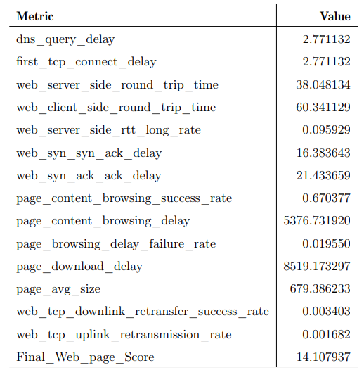
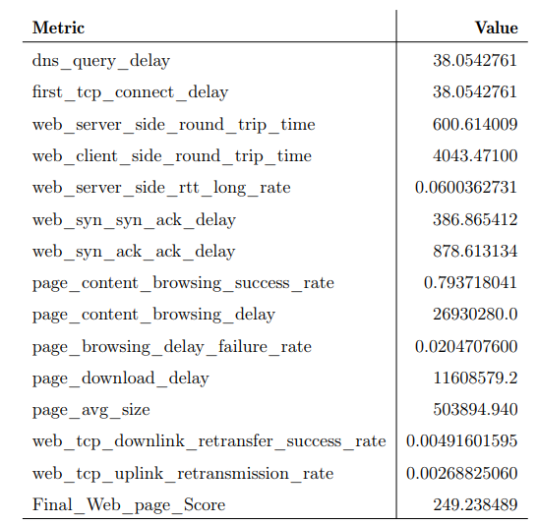
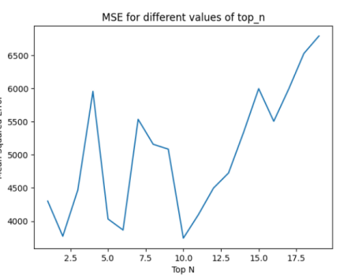
Recommendation
30

Slide 31
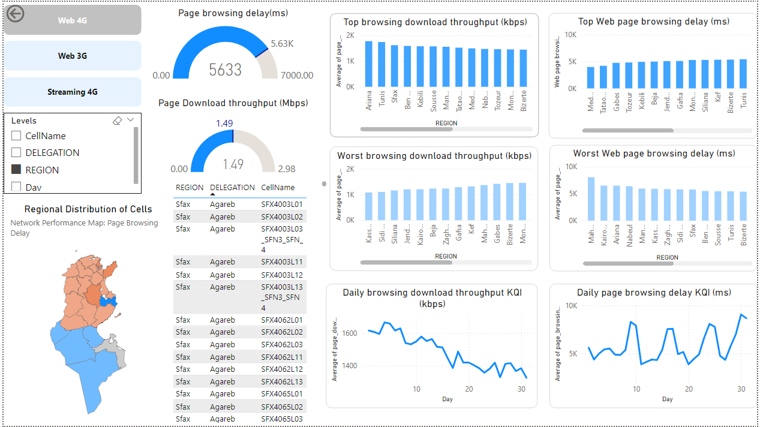
Visualisation
31

Slide 32
07
Conclusion

Slide 33


Conclusion
The project transitioned from a reactive NOC to a proactive SOC, enhancing network performance and user experience.
Implemented predictive models and recommendation systems to address network issues efficiently.
Provided real-time insights through dynamic dashboards, advancing proactive network management.
Enhanced technical expertise and applied innovative solutions in telecommunications.
33

Slide 34
Prespective
Advanced Automation:
Incorporate AI-driven decision-making to automate issue detection and resolution.
Wider Deployment:
Scale the framework for multi-technology environments, including 5G and cloud-based networks.
Data Enrichment:
Integrate external data sources like weather patterns or traffic loads to enhance prediction accuracy.
Future Innovation:
Explore machine learning advancements to improve system adaptability and long-term efficiency.
34

Slide 35


















THANKS!

